Slide 1
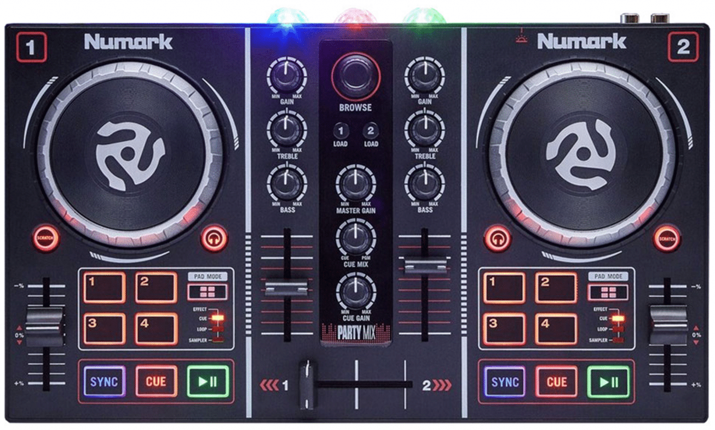
PartyMix: Overview
Filter/ Gain
Cycle LEDs
Treble+Mid/ FX depth
Load / Unload
Bass / Echo Depth
Shift #1
PFL
Next Page, goto Cues, Goto Index
Tempo, Zoom, Tempo Range
Shift #2 / Sync / FX grid --
Play Pause / Goto Back
Cue / FX Grid ++

Slide 2
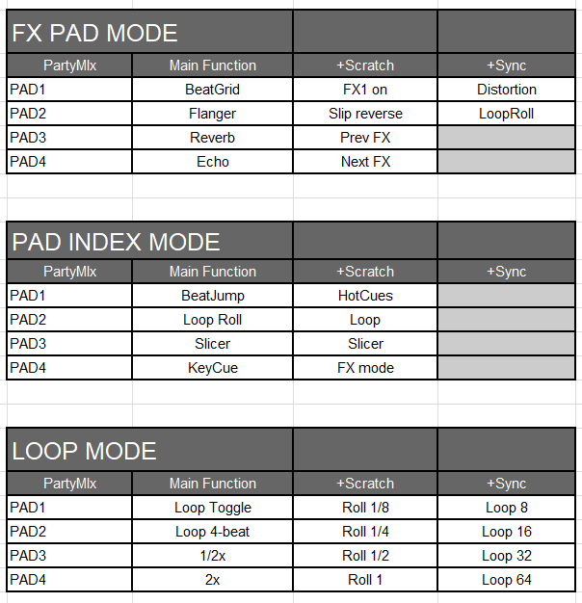
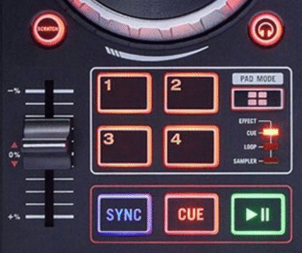
PAD MODES:
PartyMix: Shifts
Shift #1
Shift #2

